Slide 1
Interpretation and Analysis of Metacells generated by the SEACells Algorithm
Harshit and Marek

Slide 2

Reminder
Single cell data is noisy.
Traditional Clustering ends up aggregating heterogeneous cell types.
SEACells identifies metacells that can be seen as a collection of homogenous cells.
We are trying to understand the structural properties of the convex hull on which these Metacell lie and hopefully assign biologically relevant meaning to it.

Slide 3
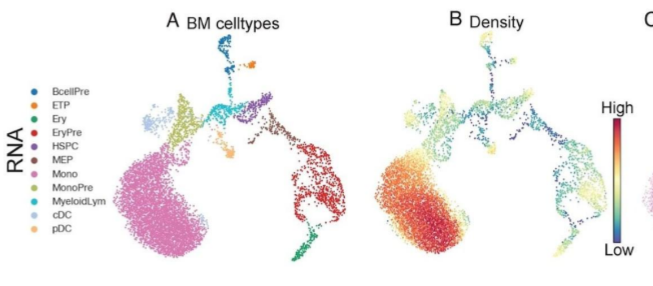
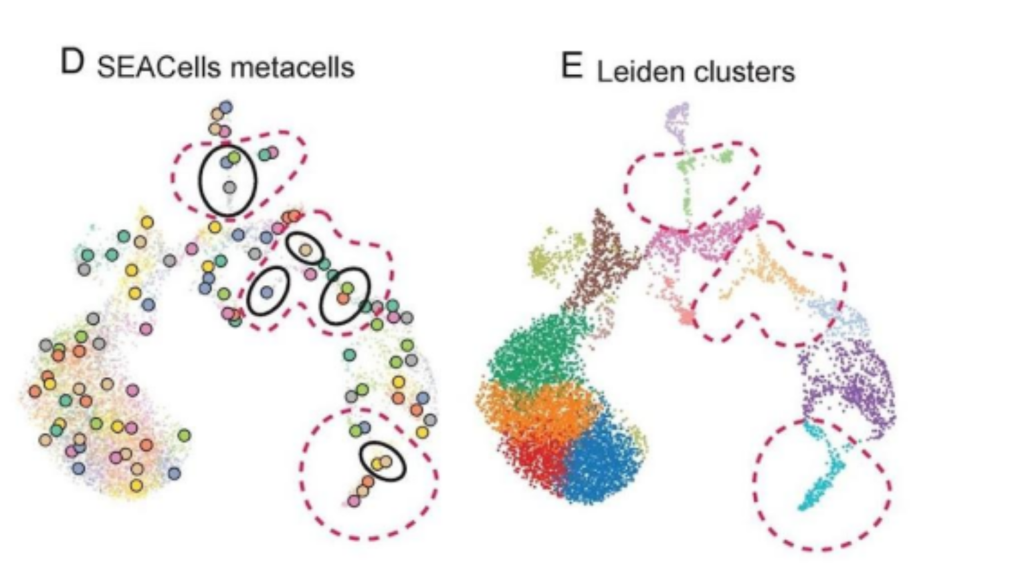

Slide 4
Algorithms and Methods Implemented (1)
def MB_graph(similarity matrix @ archetype matrix):
output: complete graph, i.e., convex hull
def project_cells_2D(cell coordinates, MB_graph):
output: closest edge, distance to closest edge, position on the closest edge, list of all projection distances
def dictionaries(various):
output: metacell dictionary, edge dictionary, cell-in-2D dictionary, cell-in-3D dictionary
All these dictionaries have been computed for different numbers of user-specified SEACells and later have been saved for further analysis as pickle objects.
+ boilerplate code for statistical analysis, whenever deemed necessary

Slide 5
Algorithms and Methods Implemented (2)
N choose 3 Matrix:
Input: N selected SEACells
Let M be a matrix of shape (3*comb(N,3), dimensions of N)
for i in nCr(N, 3) do:
Unpack i to 3 chosen indices and 3 chosen rows of data
Insert the unpacked data to consecutive rows of matrix M
return M
Note: itertools sorts the nCr output
Graph of Planes:
Input: N choose 3 Matrix
Let G = NetworkX Graph.
for i in range(0, N*3, 3):
v1 = N[i+1] - N[i]
v2 = N[i+2] - N[i]
name = SEACells associated with rows N[i : i+2]
Add as a node to G: (name, (v1, v2))
return G
Note: An edge connecting two nodes (not implemented) would represent the intersection of the two considered planes.
Project Cells in 3D:
Input: cell coordinates, graph of planes = G3D
Let min_distance = ∞, closest_plane = None.
for each node of G3D:
# Define the hyperplane
v1, v2 = node[‘data’]
# Gram-Schmidt -> Orthonormal Basis
u1 = v1/norm(v1), u2 = v2 - dot(v2,u1) * u1, u2 = u2 /norm(u2)
# orthogonal complement to hyperplane
W: lambda x: dot(x,u1)*u1 + dot(x,u2)*u2
# project the cell to the plane
w = cell_coord - W
distance = norm(w)
if distance < min_distance:
min_distance = distance
closest_plane = node
return closest_plane, min_distance, w(min_distance)

Slide 6
Progress Report - Structural Analysis of Convex Hull

Slide 7
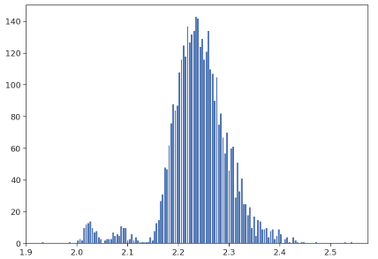
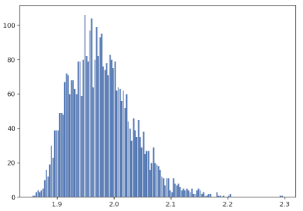
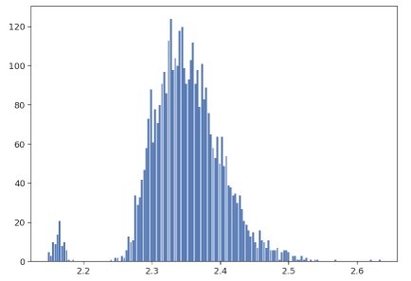
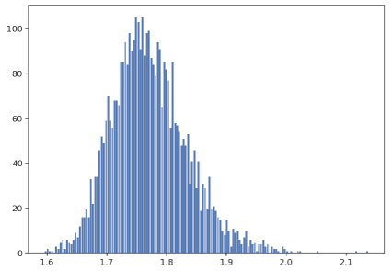
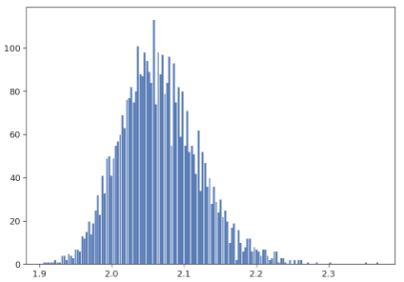
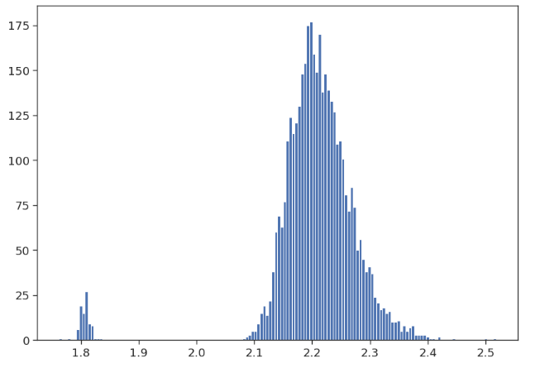
Distribution of Projection Distances of Cells to the edges of the Convex Hull
Cell 1
Cell 3
Cell 5
Cell 2
Cell 4
Cell 343

Slide 8
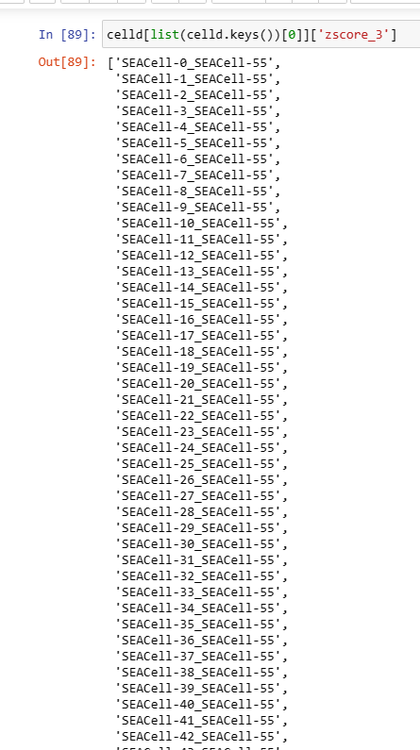
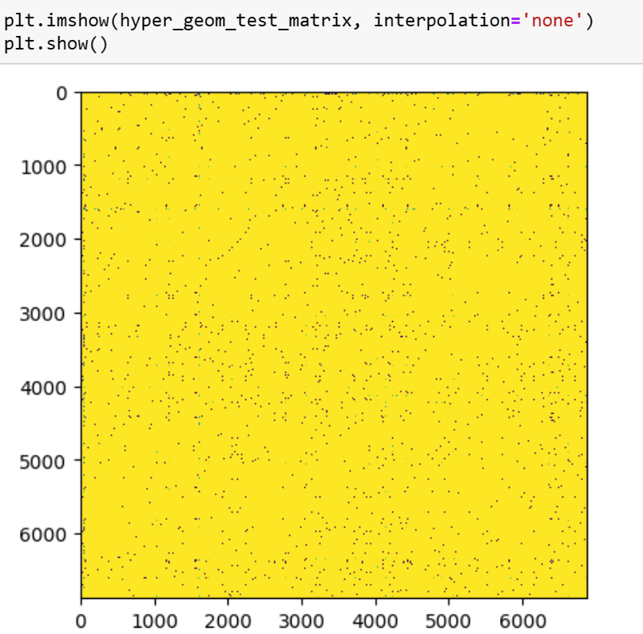
Do all these “outlier edges” have anything in common?
Do any pair/groups of cells have the same set of “outlier edges”?

Slide 9
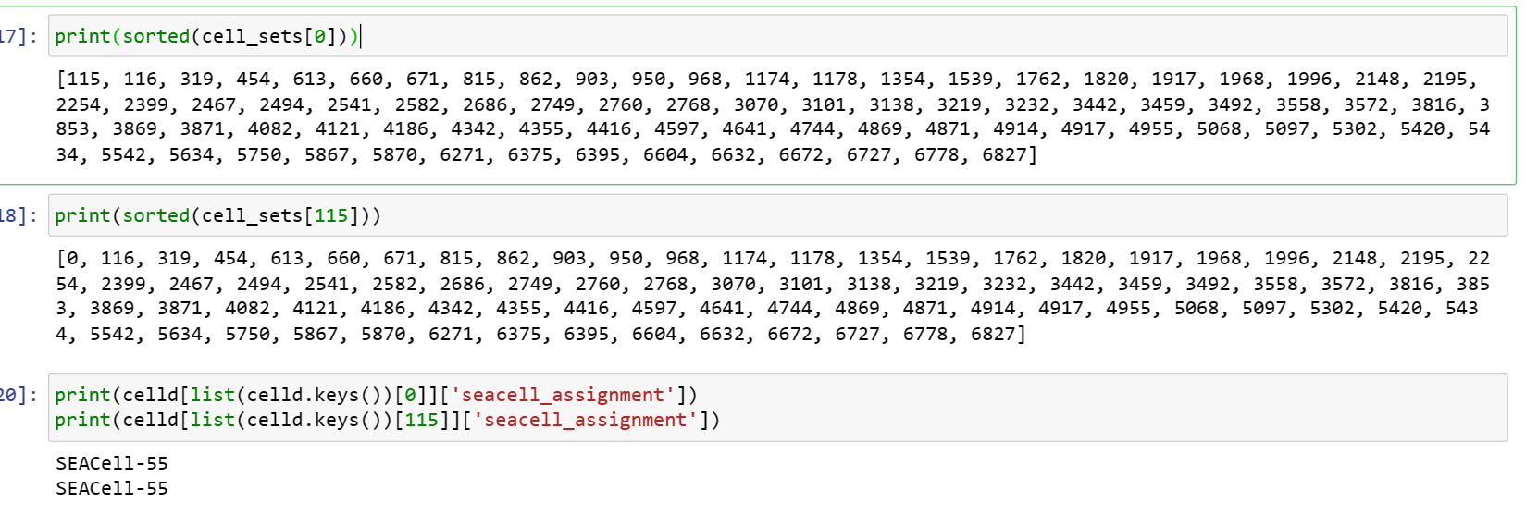
Further: Find all the groups. What is the common metacell in each of these groups? What is the density of those regions?

Slide 10
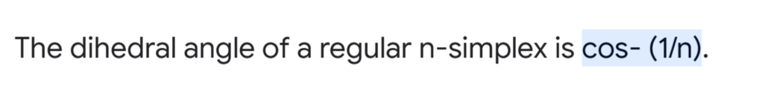
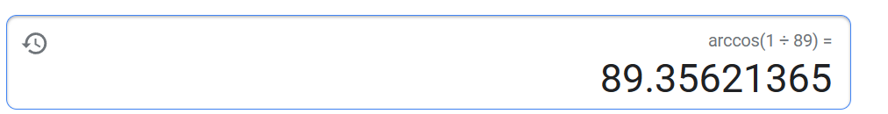
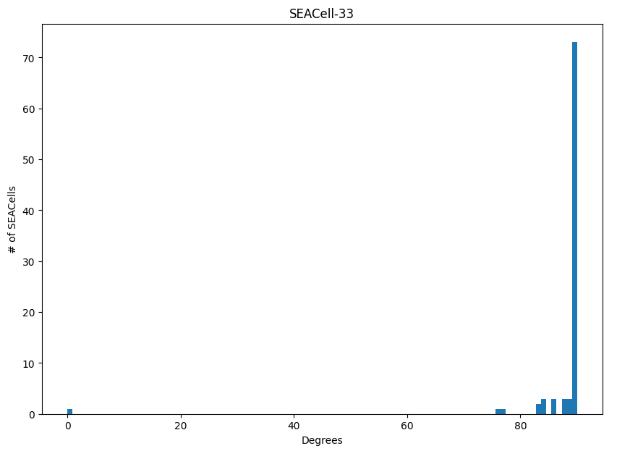
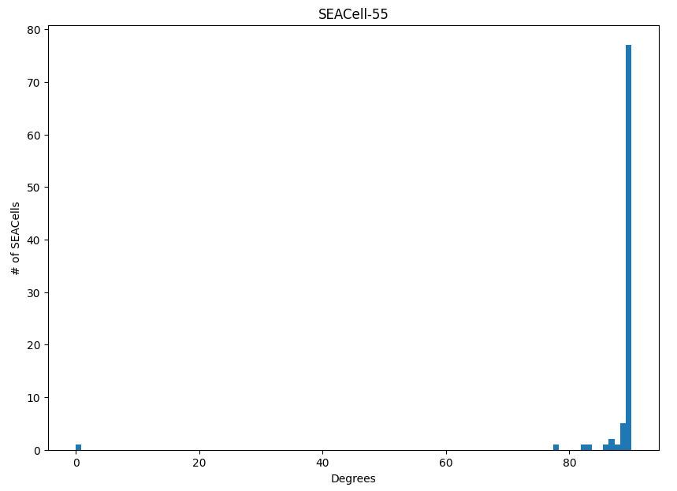
Angles in the Convex Hull

Slide 11
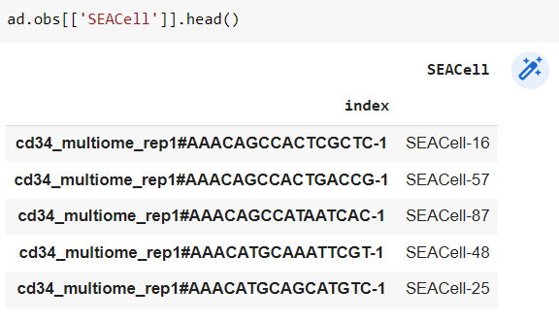
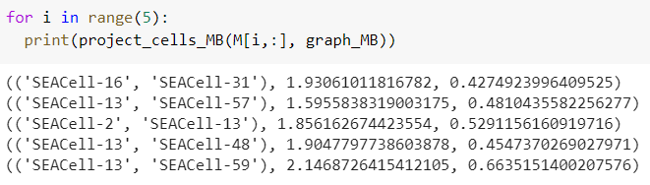
The edges don’t necessarily contain the cells assigned metacells

Slide 12
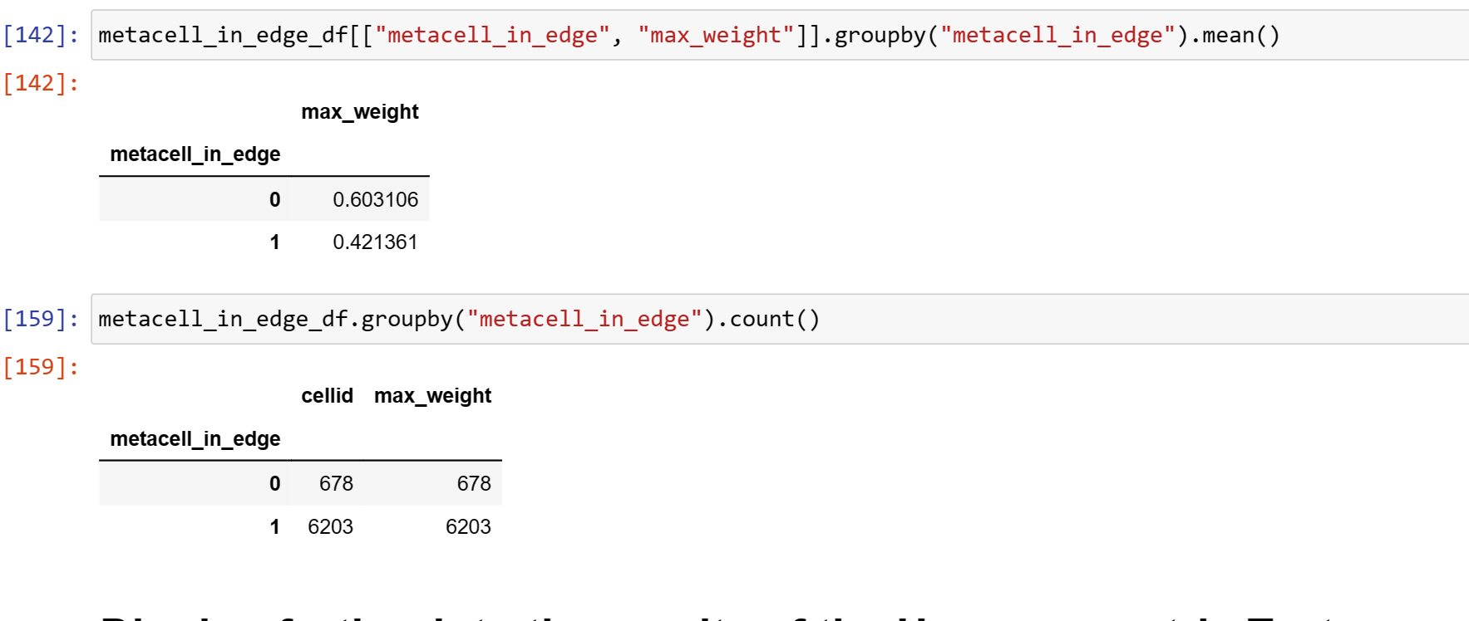
Surprising Result

Slide 13
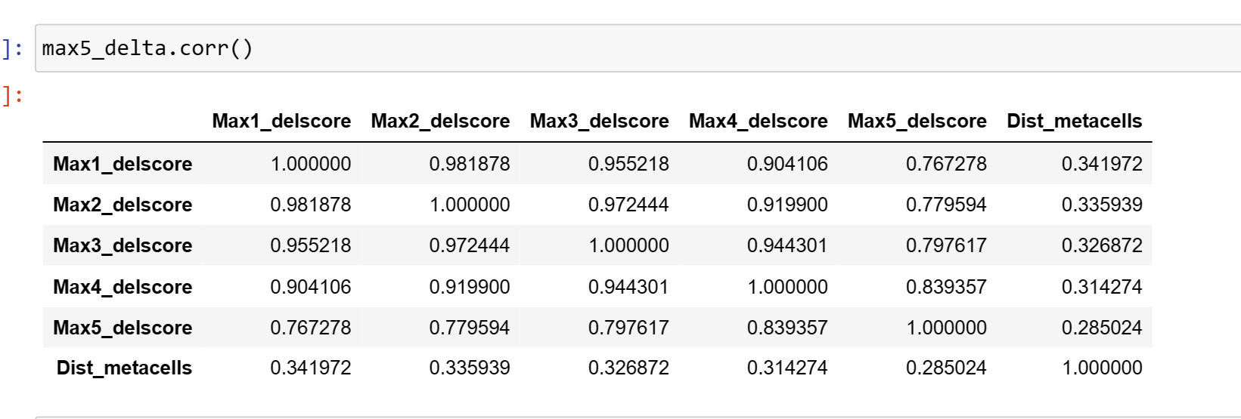
Correlation between edge length and difference in gene regulation

Slide 14
Going Ahead
Robust Statistical Analysis of the Questions we have asked
Somehow try to invert the polytope to the gene expression (PCA) space
Polish our scripts and run it for different number of Metacells
Compare polytope structure

